Slide 1
Keeping Your Research Safe with Backups

Slide 2


Slide 3
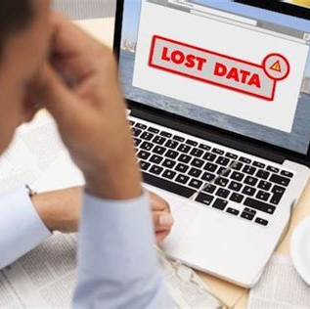

Why Should You Backup?
Data Loss Horror Stories
Data Loss Success Stories
Notes:
Why Should You Backup? “Unfortunately, I know many people who didn’t back their work up until they had something really bad (or almost bad) happen to them. Anything from data being corrupted, to a computer being damaged.”
Data Loss Horror Stories – Sh. did all his work on a laptop, someone stole his backpack out of his car, all data gone. Undergrads doing part of a project over the summer, they leave without telling me where the data is. “Does anyone have a horror story of their own they’d like to share?”
Data Loss Success Stories – “What about a success story?” Trying to make room on my free Dropbox accnt, deleted some files and the “trash” folder, panicked when I realized it was my dissertation !! But then I remembered my back-up hard drive on my machine in my office

Slide 4

Who Should Backup?
Notes:
Should a graduate student back up their dissertation or thesis?
Should a professor back up the book they’re writing?
Who else?
What about the stay-at-home dad of two kids? Well, does he have information/data/work?
Anyone who has anything that they don’t want to lose. One thing to think about in your personal lives – photos!

Slide 5
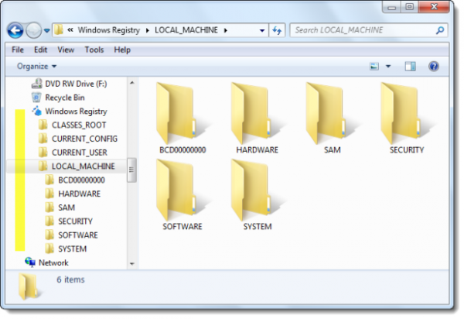
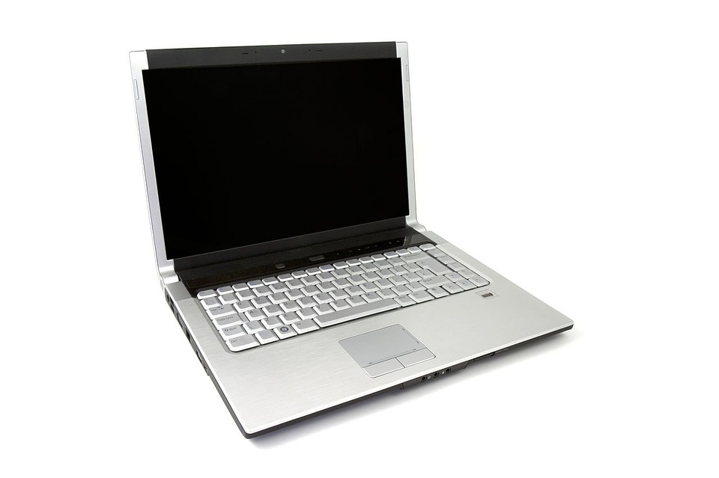
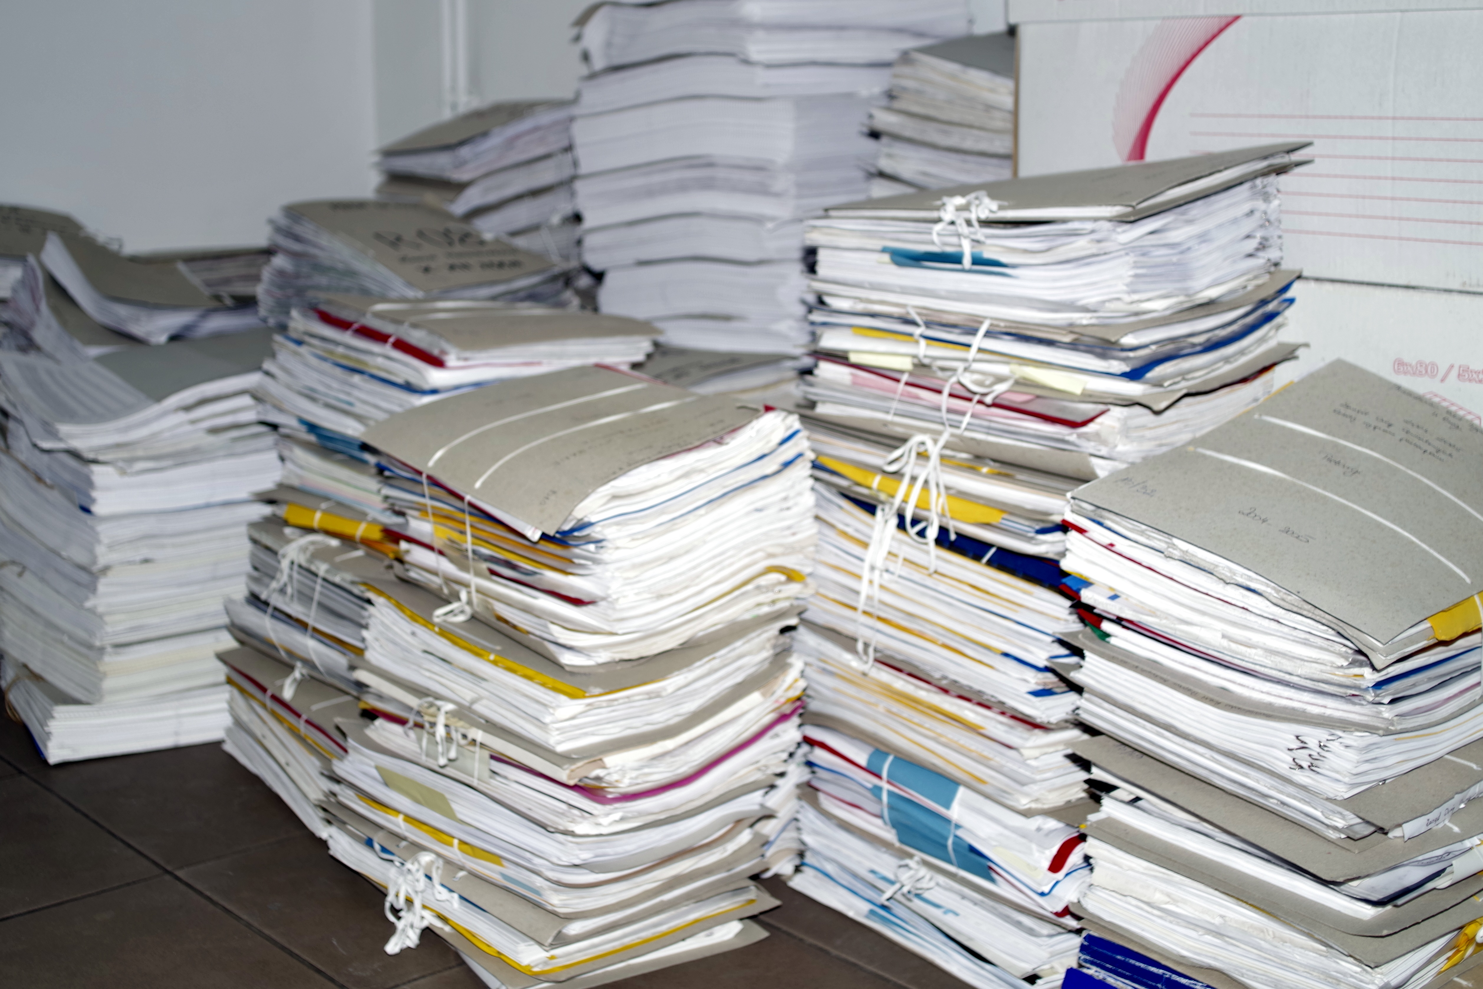
What Should You Backup?
Notes:
So let's talk a little more about what to back up.
We often think of backing up our computers, digital things, but it's important to remember that hard copies need to be considered. (Sa. scanned her lab notebook once a week and saved the files.)

Slide 6
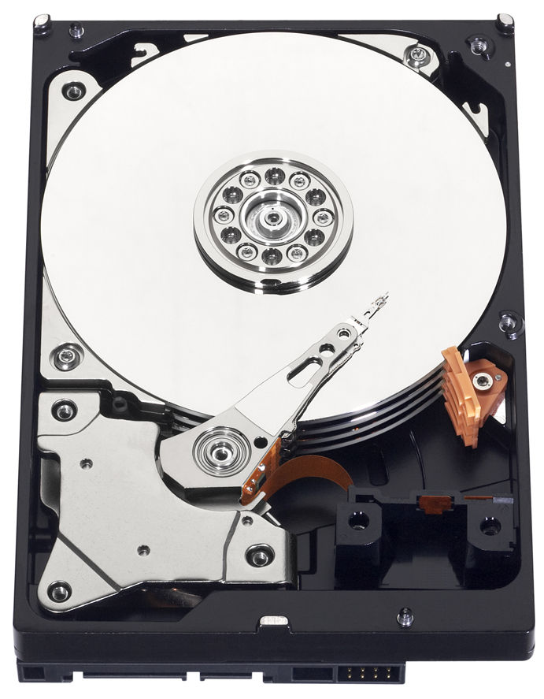
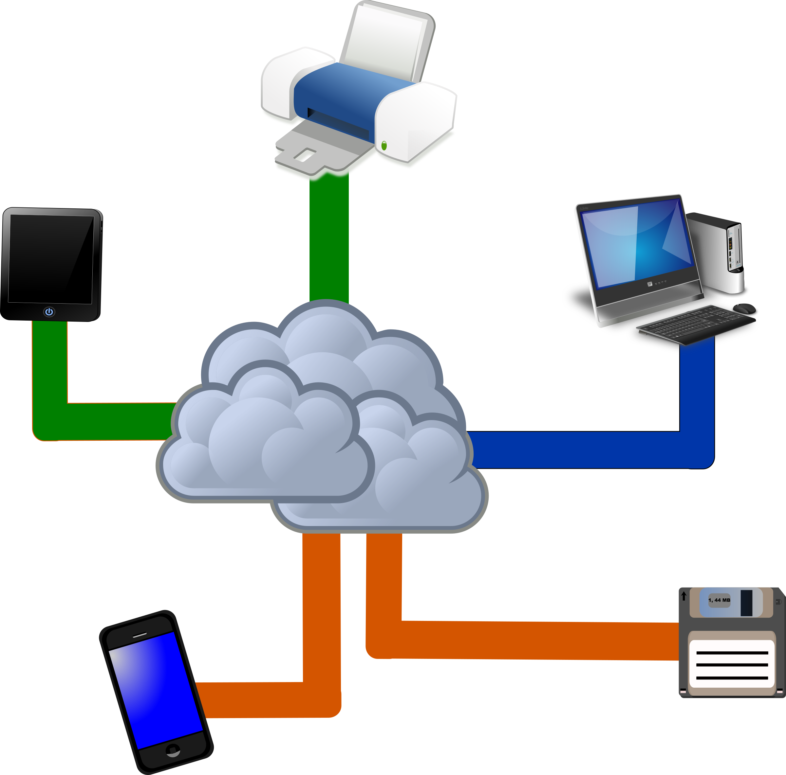
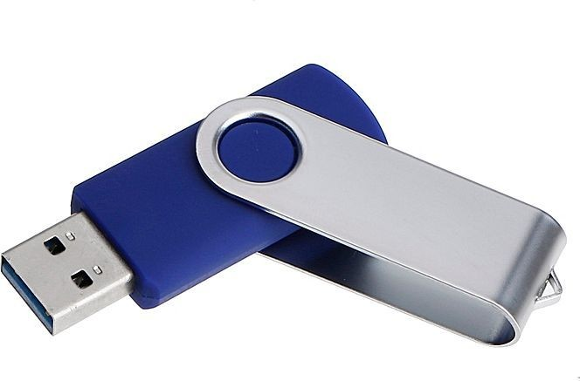
Where Should You Backup?
Notes:
Hard disks or external drives, the cloud, or even print copies...
But what about these? Flash drives? You can now get some with several GB for not much money but…
Not designed for storage – unreliable
Small – can be easily lost or damaged

Slide 7
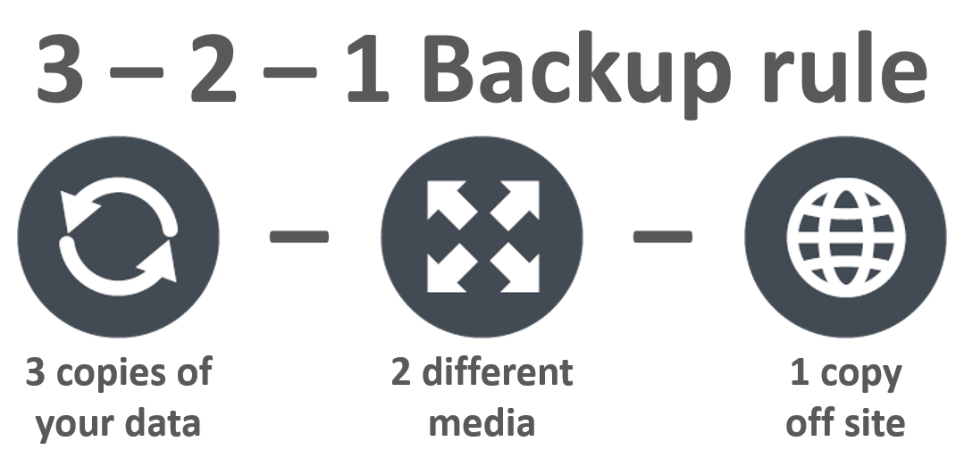
Where Should You Backup?
Notes:
Beware of syncing cloud services!

Slide 8
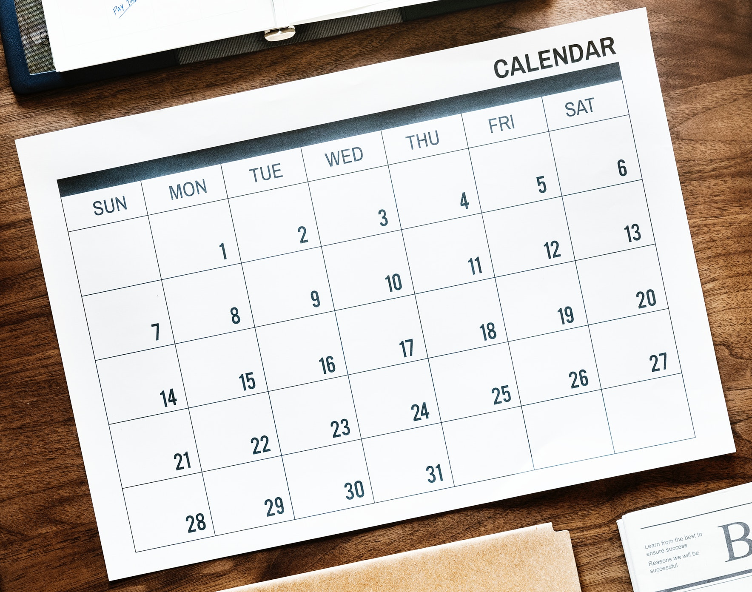
When Should You Backup?
It Depends…
How often does the data change?
How much work would be lost between backups?
What would it cost to replace the work?
How much work does it take to backup?
Notes:
A risk- benefit analysis.

Slide 9
When Should You Backup?
Start a Backup Culture
Work as a team
Clearly define responsibilities
Have a regular Backup Day

Slide 10

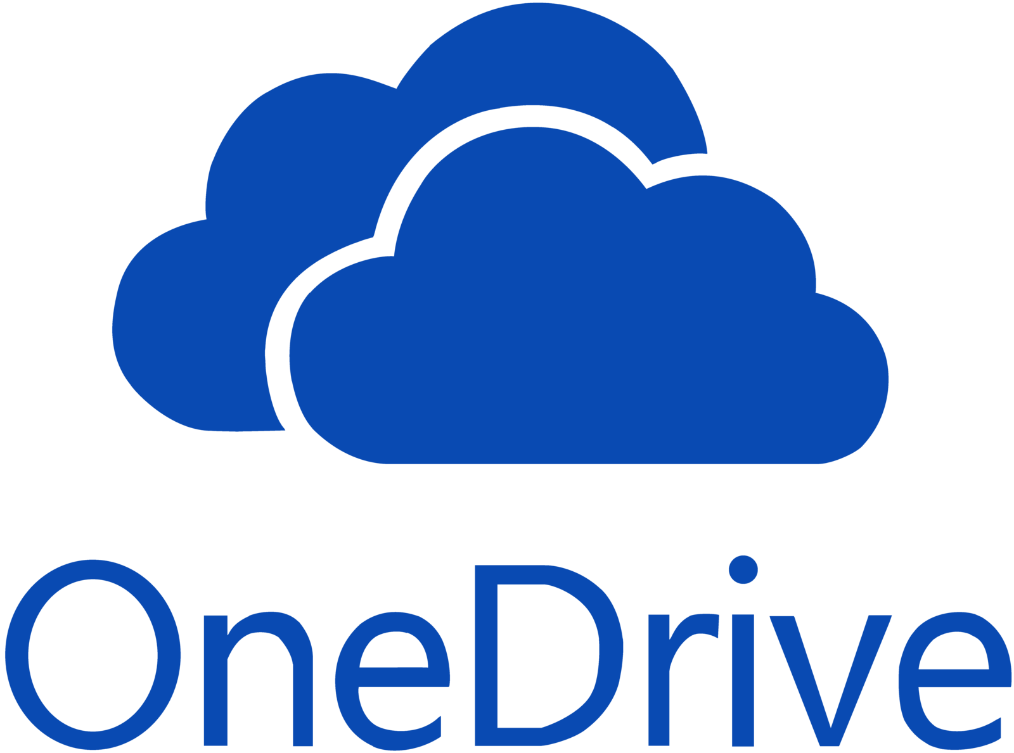


How Should You Backup?
Github
TimeMachine Macs, Windows Backup, Rsync
Commercial Packages
Remember
IRB, HIPPA sensitivity of data
Build cost into grants
Good DMPs (See DAVIS!)
And many others…

Slide 11
Case Studies
Who should backup?
What should be backed up?
Where should backups be done?
When should backups be done?
Why should backups be done?
How should backups be done?

Slide 12
Case Studies
Case Study #1
Rike is an assistant professor in the English Department. She is working on several novels and short stories in addition to materials that she creates for the courses she teaches. She keeps most of her files on her desktop for easy access but she is always worried about accidentally deleting them. To alleviate these fears she makes a point to copy the entire contents of her desktop directly into the documents section of her computer so that she can recover the previous day’s work if she accidentally deletes it.
What are good backup practices that Rike is using?
Where could she improve?
What are major risks in her backup plan?

Slide 13
Case Studies
Case Study #2
Kayin is an undergraduate student majoring in Psychology. They have heard horror stories about other students losing their work so they make a point to keep all of their class materials in their favorite cloud storage folder, that way there is always a copy of them should something happen. They also have started doing research in a lab and have created a separate folder to keep the data and results from their research in the cloud as well.
What are good backup practices that Kayin is using?
Where could they improve?
What are major risks in their backup plan?

Slide 14
Case Studies
Case Study #3
Eser is a graduate student in the Engineering Department. His work frequently involves manuscripts, code and scripts, and 3D renderings that take a several hours each to process. Eser works primarily on lab computers in his department that have the processing power to do his work. He is paranoid that something will go wrong with those computers so he always works off his flashdrive so he can take his data home with him. Occasionally he will copy the output of his work over to his personal laptop to have a copy there to work with when he is away from the computer lab.
What are good backup practices that Eser is using?
Where could he improve?
What are major risks in his backup plan?

Slide 15
Your backup plan
Who should backup?
What should be backed up?
Where should backups be done?
When should backups be done?
Why should backups be done?
How should backups be done?

Slide 16
Get help and learn more
Scheduled data workshops
https://libraries.ou.edu/events
Workshops on request
https://libraries.ou.edu/workshops-on-request
Information Specialists https://libraries.ou.edu/davis
https://libraries.ou.edu/dsl

Slide 17
Upcoming events!
Nov 18, 3pm: Presentation Concepts & Practice
Nov 19, 11am: Managing Research Projects with OSF
Nov 23, 2pm: Visualization in R using ‘ggplot2’
Dec 10, 2pm: Repetitive tasks in R

Slide 18
Please take 3 min to help us improve
Survey link: https://ou.libwizard.com/f/datasurvey
Workshop topic: Survival Skills: Backups 101
Workshop date: 11/4/20
This slide deck available on our archive at https://osf.io/aw9y3/
Notes:
A follow-up email will be sent with the link to this survey along with a link to this slide deck.

